Slide 1
Flinder Wireframes
WAD Lab Team 3B

Slide 2
Logo

Slide 3

#FFFFFF
#7A98CF
#0D5B5A
#41AD4F
#6DBB7C
#C4DEB2

Slide 4
Portrait Layouts

Slide 5


Sign In
Sign In with Google

Slide 6
Email address:
person@example.com
Password:
********
Sign In

Slide 7

Create your account
Are you looking to find a room to stay in? Or are you looking for a flatmate to fill a room?
Looking for a room
Looking to fill a room
Button
Button
Field Label
Field text
Dropdown label
Dropdown option

Slide 8
Looking for a room
Create your account
Name
Thomas
Birthday
MM/DD/YYYY
Year of study
1st
Gender
Prefer not to say
University
University of Glasgow
Continue
Button
Button
Field Label
Field text
Dropdown label
Dropdown option

Slide 9
Looking to fill a room
Create your account
Group Name
Boyd Orr Squad
Birth year
Mixed
Year of study
Mixed
Gender
Mixed
University
University of Glasgow
Scroll down to fill in more fields
Button
Button
Field Label
Field text
Dropdown label
Dropdown option

Slide 10
Looking to fill a room
Create your account
Address
Address line 1
Address line 2
Post code
Postcode
Number of bedrooms
5
Bedrooms available
2
Continue
Button
Button
Field Label
Field text
Dropdown label
Dropdown option

Slide 11
Tell us about your preferences
Gender
Mixed
Same
Year of study
Mixed
Same
Age
Mixed
Same
Maximum distance
2 km
Interests
(multiple selected)
Continue
Button
Button
Field Label
Field text
Dropdown label
Dropdown option

Slide 12
Upload photos
+
Continue
Button
Button
Field Label
Field text
Dropdown label
Dropdown option

Slide 13


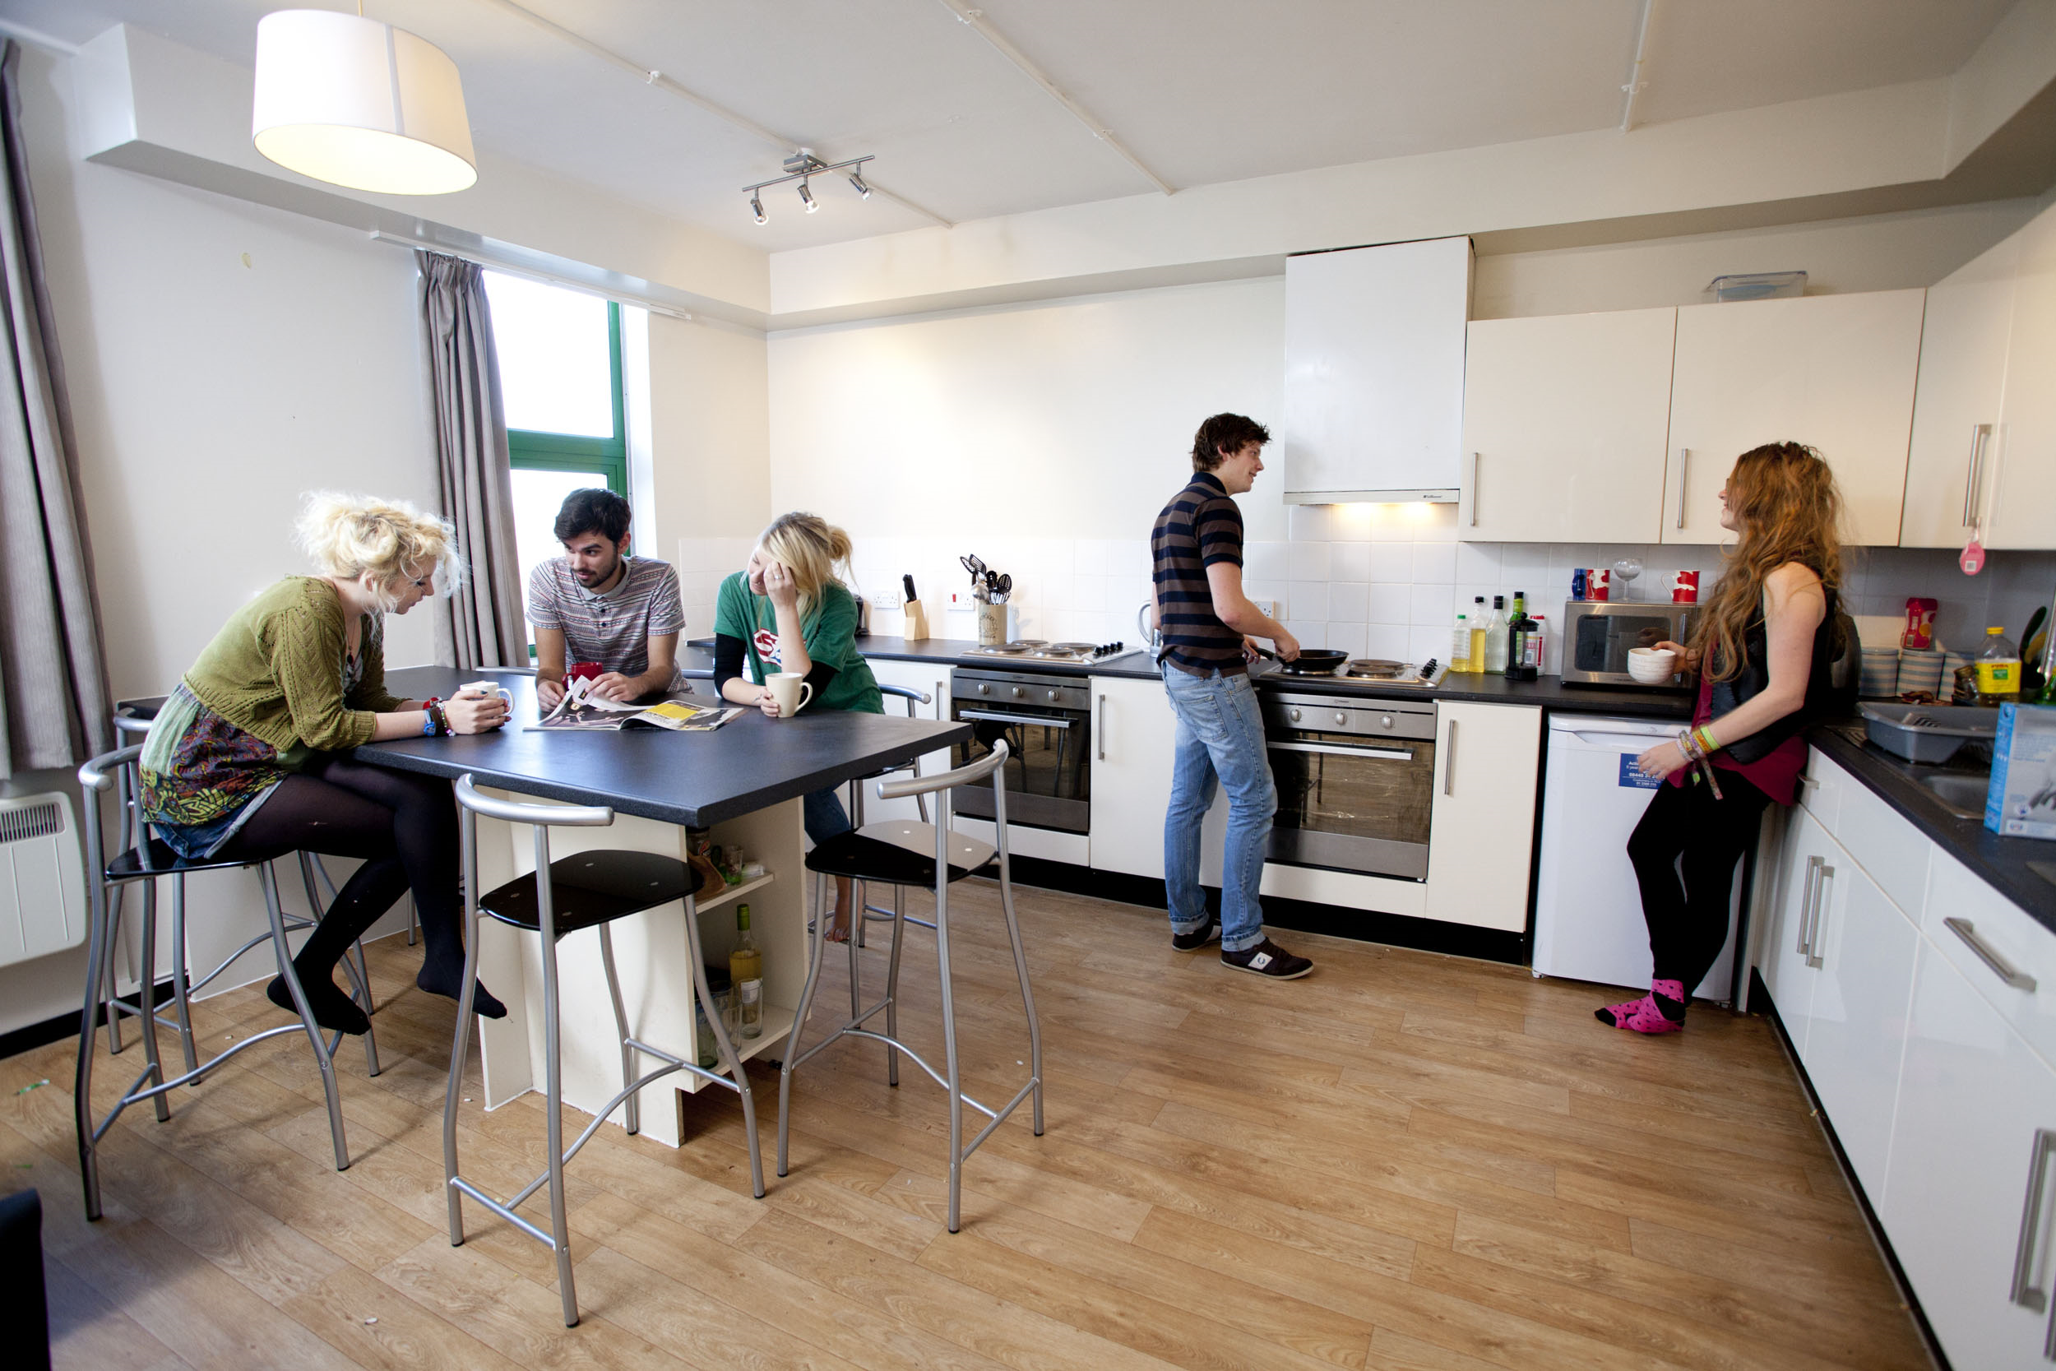


Opens profile page
Opens matches page
Dislikes the current profile
Boyd Orr Gang
Flat of 5 on Byres Road
Likes the current profile
Button
Button
Field Label
Field text
Dropdown label
Dropdown option

Slide 14

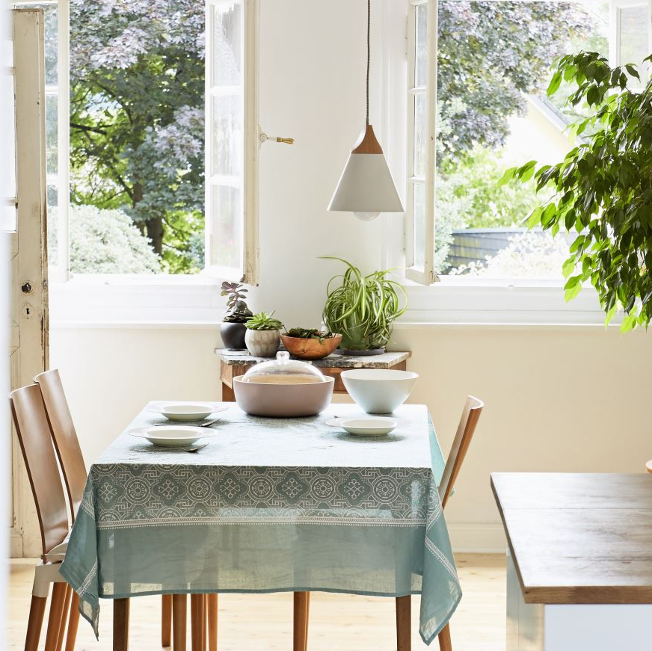
Your matches
Returns to matching page
Boyd Orr Gang
Flat of 5 on Byres Road
Southpark House
Flat of 3 on Southpark Avenue
Click to view the profile and get contact details
Button
Button
Field Label
Field text
Dropdown label
Dropdown option

Slide 15
Landscape Layouts

Slide 16
Sign In
Sign In with Google

Slide 17
Email address:
person@example.com
Password:
********
Sign In

Slide 18
Create your account
Are you looking to find a room to stay in? Or are you looking for a flatmate to fill a room?
Looking for a room
Looking to fill a room
Button
Button
Field Label
Field text
Dropdown label
Dropdown option

Slide 19
Looking for a room
Create your account
Name
Thomas
Birthday
MM/DD/YYYY
Year of study
1st
Gender
Prefer not to say
University
University of Glasgow
Continue
Button
Button
Field Label
Field text
Dropdown label
Dropdown option

Slide 20
Looking to fill a room
Create your account
Group Name
Address
Boyd Orr Squad
Address line 1
Birth year
Address line 2
Mixed
Post code
Postcode
Year of study
Mixed
Number of bedrooms
5
Gender
Mixed
Bedrooms available
2
University
University of Glasgow
Continue
Button
Button
Field Label
Field text
Dropdown label
Dropdown option

Slide 21
Tell us about your preferences
Gender
Mixed
Same
Year of study
Mixed
Same
Age
Mixed
Same
Maximum distance
2 km
Interests
(multiple selected)
Continue
Button
Button
Field Label
Field text
Dropdown label
Dropdown option

Slide 22



Upload photos
+
Continue
Button
Button
Field Label
Field text
Dropdown label
Dropdown option

Slide 23

Opens profile page
Click to view the profile and get contact details
Opens matches page
Your matches
Knowles’ Nook
Flat of 4 on Dumbartum Road
Southpark House
Flat of 3 on Southpark Avenue
Dislikes the current profile
Boyd Orr Gang
Flat of 5 on Byres Road
Likes the current profile
Button
Button
Field Label
Field text
Dropdown label
Dropdown option

Slide 24
Your matches
Returns to matching page
Boyd Orr Gang
Flat of 5 on Byres Road
Southpark House
Flat of 3 on Southpark Avenue
Click to view the profile and get contact details
Button
Button
Field Label
Field text
Dropdown label
Dropdown option

